Slide 1


Azure Resource Manager In A Serverless World
Eldert Grootenboer

Slide 2


Eldert Grootenboer
@egrootenboer

Slide 3

Introducing Boskalis

Slide 4










Cloud native strategy
Platform
Event Grid
Logic Apps
Functions
Manage all events that can trigger code or logic
Design workflows and orchestrate processes
Execute your code based on events you specify
API Management
Container Instances
Application Insights
Scalable API gateway for securing, publishing, and analyzing APIs
Run application containers in the cloud with a single command
Extensible Application Performance Management service
Database
Storage
Security
IoT
Analytics
Intelligence
Notes:
Pay as you go
Infinite scale
Don’t do infrastructure anymore

Slide 5

Infrastructure as Code

Slide 6
Infrastructure as Code (IaC) is the management of infrastructure (networks, virtual machines, load balancers, and connection topology) in a descriptive model, using version control to store the files.
Notes:
Or said another way. IaC is taking the environment upon which you intent to run your application and codifying it. The code is stored in version control and acted on using a CI/CD pipeline. No manual steps are taking in the portal to provision an environment.

Slide 7
Why Infrastructure as Code
Review changes
Cattle, not pets
Consistency
Reduce human error
Quickly set up environments

Slide 8
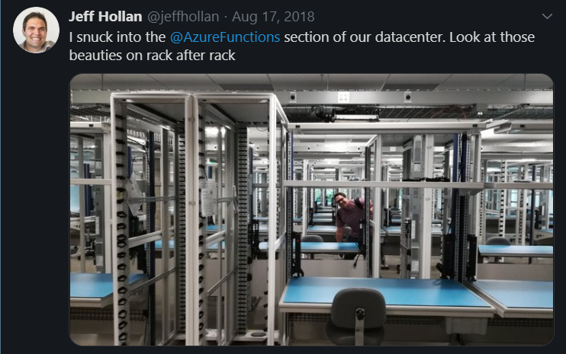
But what about serverless and IaC?

Slide 9

IaC on Azure
Notes:
7

Slide 10
Various options
Azure Resource Manager Templates (ARM)
Azure CLI
PowerShell
Code (SDKs)
Terraform
Ansible
Chef
Puppet

Slide 11
Benefits of ARM
First class citizen
Desired-state deployment
Idempotent
Faster deployments
Modular
DevOps
Extensible
Integrated
Easy authoring
Tracked deployments

Slide 12

Templates
Notes:
12

Slide 13
Template structure
{
"$schema": "https://schema.management.azure.com/schemas/2019-04-01/deploymentTemplate.json#",
"contentVersion": "1.0.0.0",
"parameters": {},
"variables": {},
"resources": [],
"outputs": {},
"functions": []
}
Notes:
Describe the various fields

Slide 14
ARM templates
Parameterized
Idempotent
Outputs

Slide 15
Simple or complex resources
Sequencing
Nesting
Linking
Looping

Slide 16
Best practices
Don’t overuse parameters
Use well-chosen defaults
Utilize variables for re-use
Apply tags from templates
Dynamically retrieve secrets and settings
Derive values using functions
Use modular templates
Minimize duplicate resources
Simplify through user-defined functions

Slide 17

Quickstart Templates
Notes:
https://github.com/Azure/azure-quickstart-templates
https://github.com/Azure/azure-quickstart-templates/blob/master/101-cosmosdb-mongodb/azuredeploy.json

Slide 18

Authoring
Notes:
17

Slide 19
Visual Studio Code
ARM Templates extension and language
Intellisense
Syntax highlighting
Snippets
Schema validation
ARM Template Viewer

Slide 20
Bicep
DSL
Declarative
ARM JSON as Intermediate Language
Full feature parity
Transparent abstraction
Currently in alpha phase

Slide 21
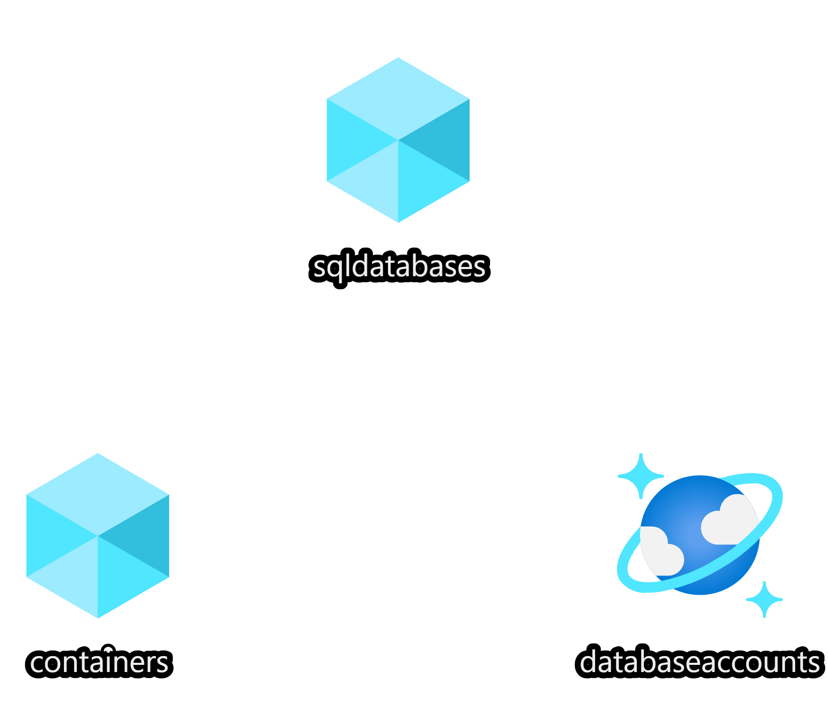
Demo
Notes:
20
demo-2-authoring-templates
Show templates
Deploy using PowerShell

Slide 22

From portal to template
Notes:
25

Slide 23
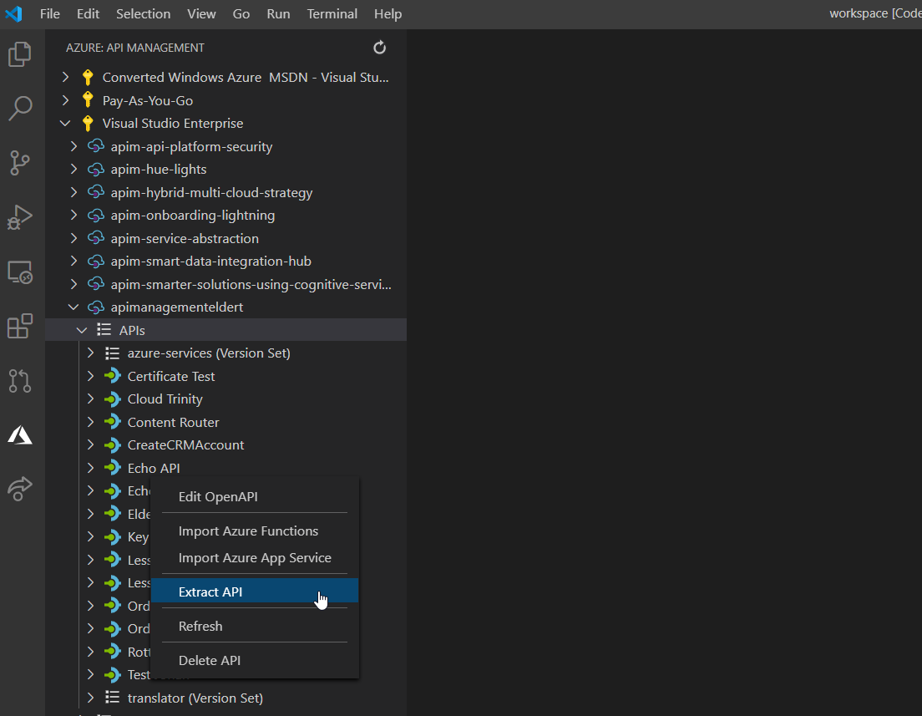
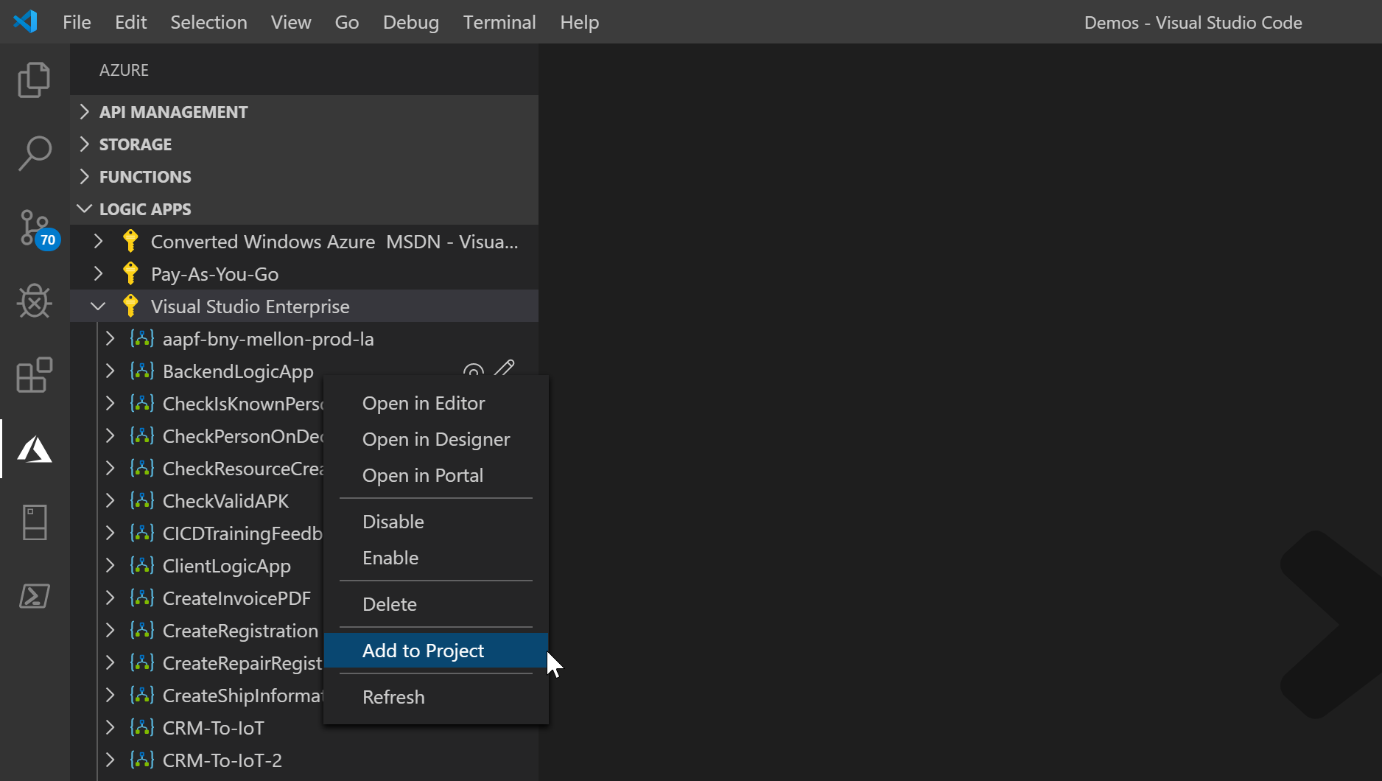
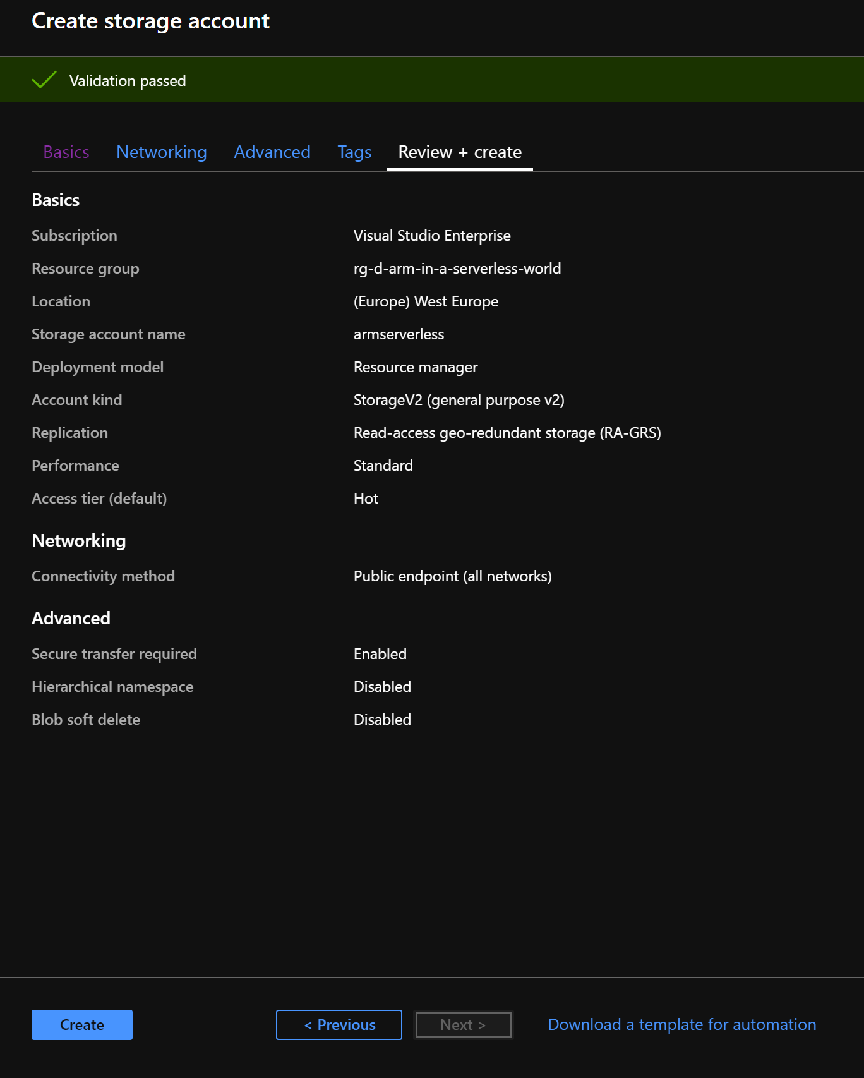
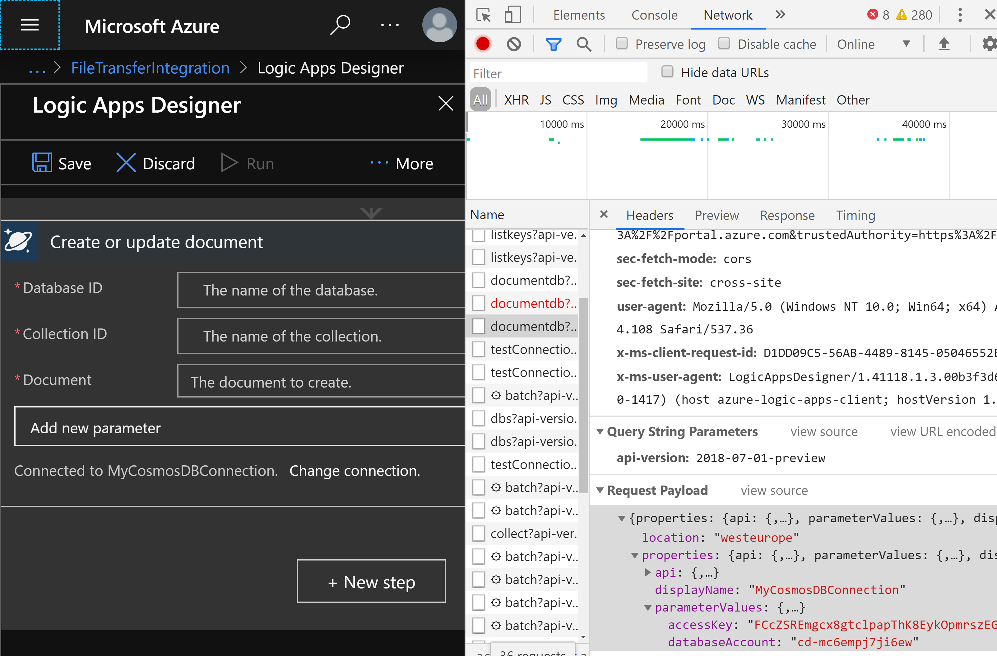
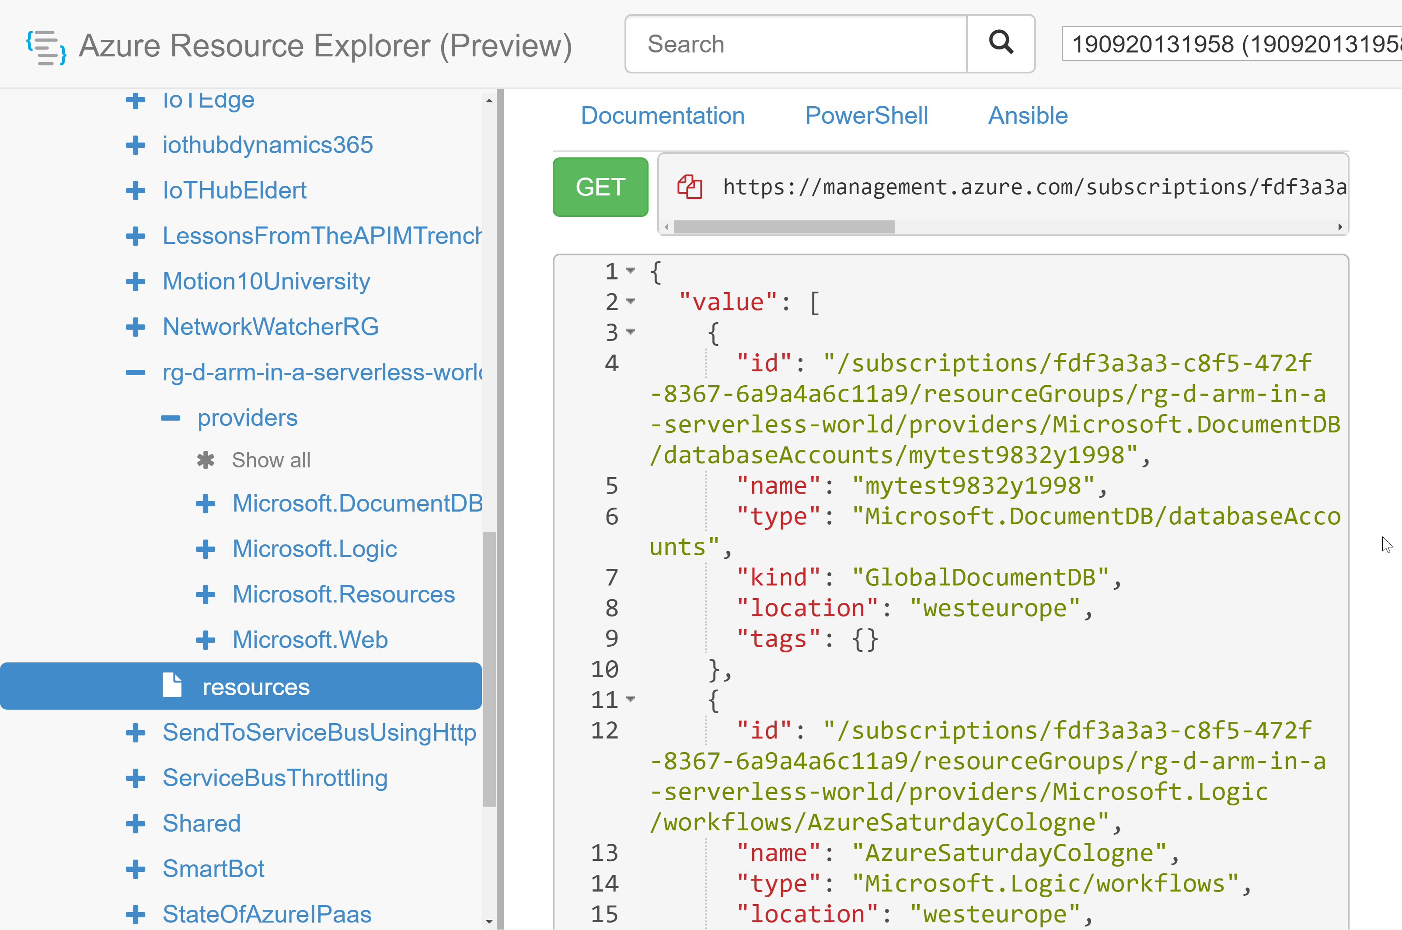
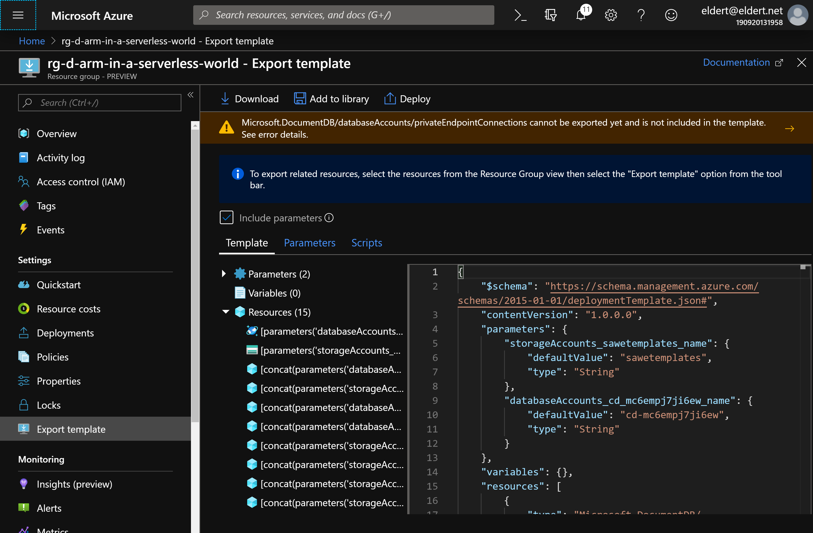
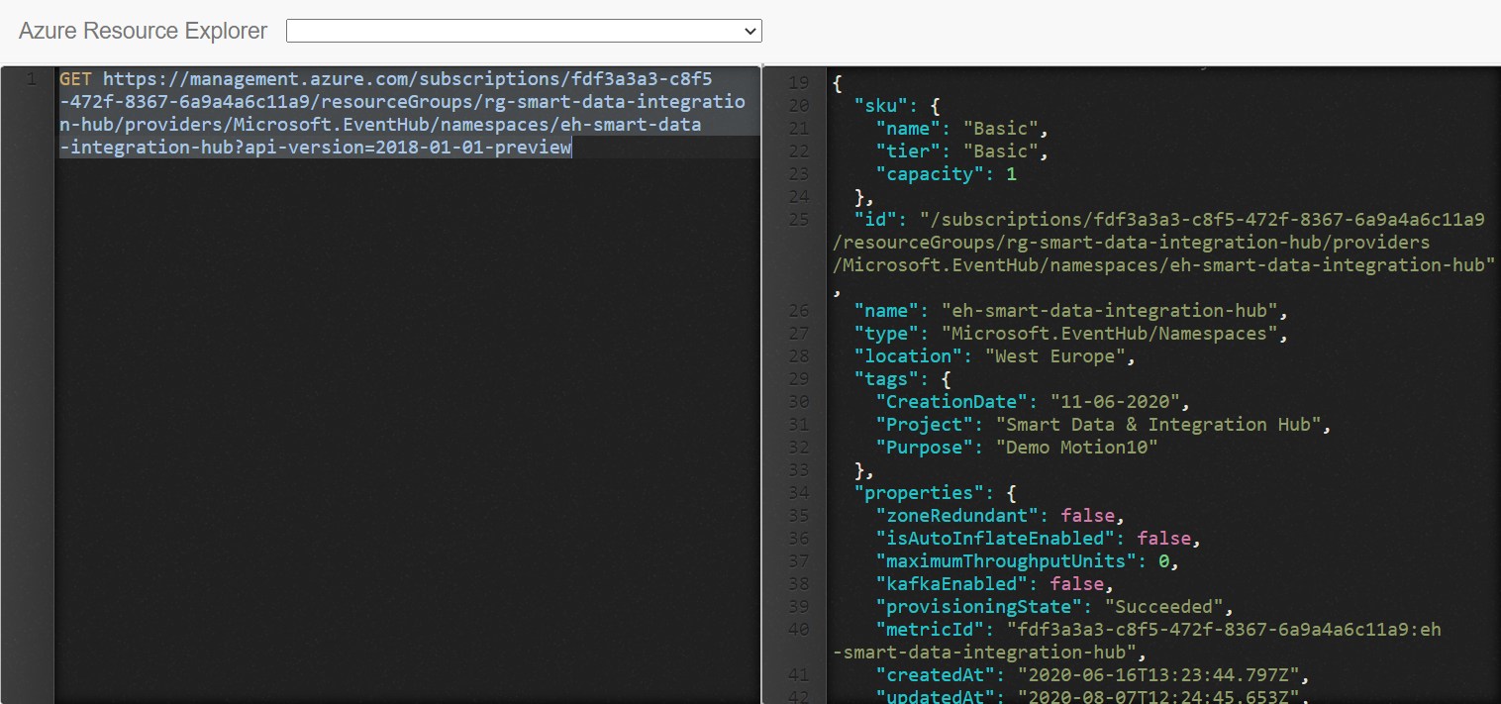
Extracting templates
Portal
Creation
Resource Explorer
REST
Debug tools
Tools
API Management
Logic Apps
Notes:
Many tools available

Slide 24
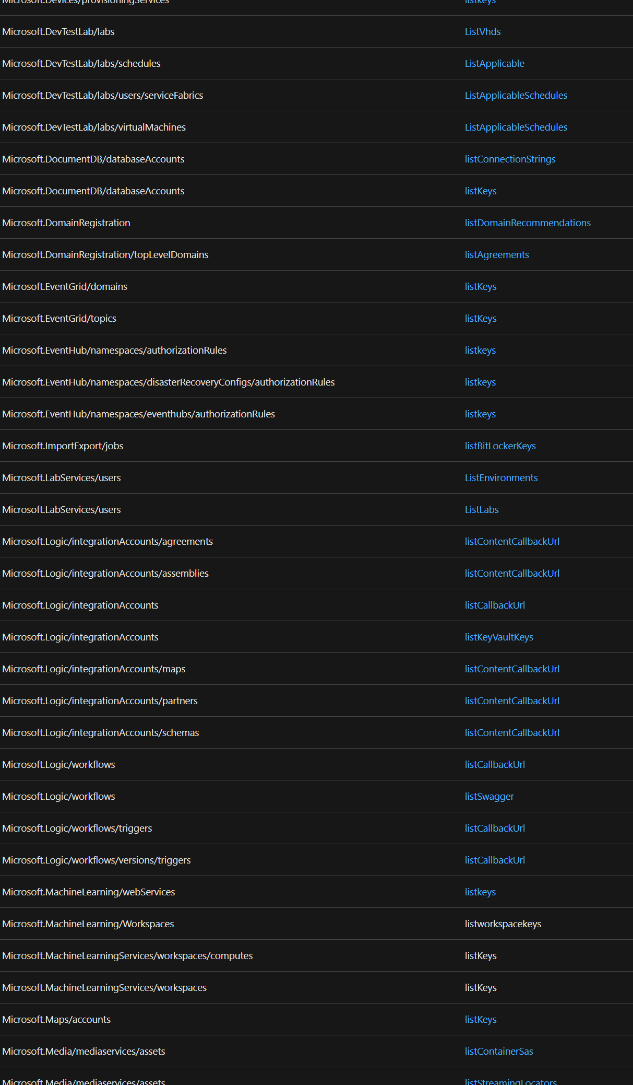
Secrets in templates
Securestring
Listkeys
Listsecrets
Key Vault
How about other settings?
List*
Reference
Notes:
We now have our template, but how do we make it more secure?

Slide 25
Deployment
Portal
PowerShell
Azure DevOps
GitHub
Notes:
Our template is now ready, how can we get it into our environments?

Slide 26
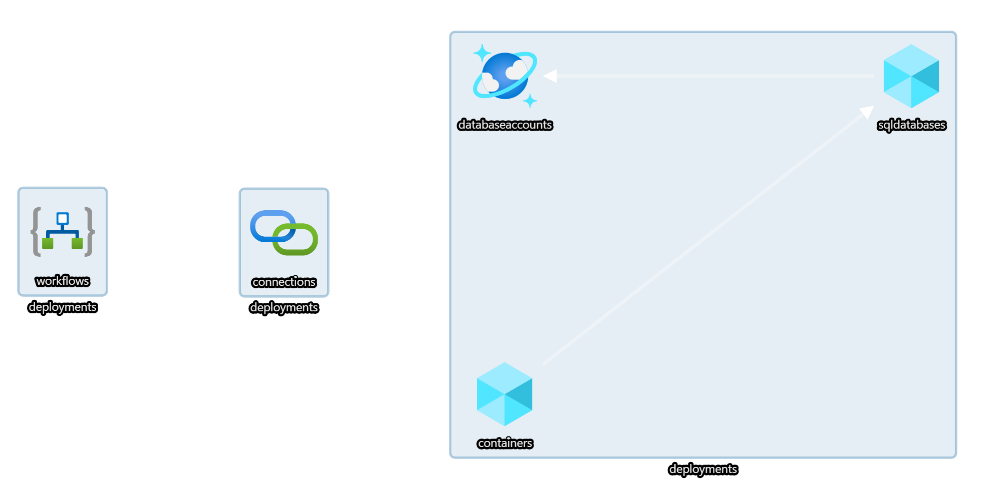


Demo
Notes:
30
demo-3-deployment
Show templates and pipelines
Show deployment using Azure DevOps (change something, check-in, sync)

Slide 27

Quality assurance
Notes:
40

Slide 28
What-If
Calculates desired state
Retrieves current state
Noise suppression service
Calculated diff

Slide 29
Azure Resource Manager Template Toolkit
Static Analysis
Guidelines & best practices
Pipeline tasks

Slide 30
Deployment script
Run arbitrary script
Replace scripts in pipeline
Think idempotently

Slide 31
Template specs
Store and share templates
Resource in Azure
Versioned
No public endpoint needed

Slide 32

Demo
Notes:
39

Slide 33

Almost done…
Notes:
55

Slide 34
Take aways
Implement resources as IaC
Follow best practices
VS Code is your friend
Automate everything
Keep improving quality

Slide 35
Resources
New to ARM: https://bit.ly/azure-arm-get-started
Quickstart templates: https://bit.ly/azure-arm-quickstart-templates
GitHub: https://bit.ly/azure-arm-quickstart-templates-github
Visual Studio Code Extensions: https://bit.ly/azure-arm-vscode-extensions
Template Toolkit: https://bit.ly/azure-arm-template-toolkit
What-If: https://bit.ly/azure-arm-what-if
Deployment scripts: https://bit.ly/azure-arm-deployment-scripts
Bicep: https://bit.ly/azure-arm-bicep
Best practices: https://bit.ly/azure-arm-best-practices

Slide 36



Thank You!
@egrootenboer
eldert@eldert.net
https://www.linkedin.com/in/eldert-grootenboer

